Slide 1
Chapter 7 – 2D Arrays
By the end of this chapter you should:
•Understand how arrays are declared and used in C
•Be able to use arrays to hold lists of data in programs

Slide 2
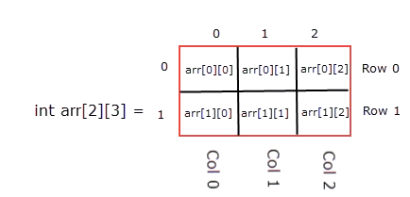
2D Arrays
So far, we’ve seen single dimensional arrays used to hold lists of data. However, you can have arrays with more than one set of indices - a multi dimensional array.
A two-dimensional array can be visualised as a table data structure (obviously it’s not really in a computer’s memory like that but it helps to understand it this abstract way)
They’re declared like this: int Myarray [10][2];
The first set of indexes represents the number of ‘rows’ and the second index is for the ‘columns’.
This 2D array would be created in memory: (although obviously it doesn’t really look like this!)
Myarray | [0] | [1]
[0]
[1]
[2]
[3]
[4]
[5]
[6]
[7]
[8]
[9]

Slide 3
Example 1
int students[2][6], iD = 0, score = 0, avg; for (iD = 0; iD < 2; iD++) { printf("Enter student number: "); fflush(stdin); scanf("%d", &students[iD][0]); for (score = 1; score < 6; score++) { printf("Enter score %d: ", score); fflush(stdin); scanf("%d", &students[iD][score]); } }
for (int i = 0; i < 2; i++) { avg=0; for (int j = 1; j < 6; j++) { avg += students[i][j]; } printf("Student %d avg is:%d \n",students[i][0], avg/5);
}
The array is declared with two indexes – this will have two rows and 6 columns of data
I enter data to the first column of the array (which is going to store each student ID number)
Then I use a nested loop to read in all 5 scores into that student’s array row
The nested loop finished and then my outer loop asks for the next student number
That number is used as the index number to access a particular element in the array and display the data stored in it on screen

